Slide 1

First Steps:
April 12, 2017

Slide 2




What Others Are Doing….
“An Introduction to Nerves”
Apr 17 (Mon) • 6:30 pm
Asynchrony • 900 Spruce St
“Docker in Practice: Binaries, Code and Configuration”
Apr 20 (Thu) • 6:30 pm
Asychrony • 1000 Spruce St
“jSTL #1 – jSTL Launch + Web + Service Workers”
Apr 25 (Tue) • 6:30 pm
CIC@CET
“Near Real-Time Ingest with StreamSets Data Collector”
May 3 (Wed) • 7 pm
CIC • 4240 Duncan Ave

Slide 3
Welcome!
About Us: Learning how to create full-stack, scalable internet applications. From the database… all the way to the front-end user interface : JavaScript Frameworks ∙ Server-Side Code ∙ Load Balancing
Meetup Calendar:
https://www.meetup.com/SaintLouis_FullStack_WebDevelopment/events/
Slack Group(s):
https://stl-tech.slack.com/messages/stl_fullstack_web_dev/

Slide 4
Background…
Mid 2000’s …. Virtualization:
Waaaaaay More Servers!
Cloud Computing
Also:
Distributed Architectures
Microservices
Big Data Infrastructure

Slide 5



Background…
The Old Guard…
Mid 2000’s …. Virtualization:
Waaaaaay More Servers!
Cloud Computing
Also:
Distributed Architectures
Microservices
Big Data Infrastructure

Slide 6

Background…
The Old Guard…
Mid 2000’s …. Virtualization:
Waaaaaay More Servers!
Cloud Computing
Also:
Distributed Architectures
Microservices
Big Data Infrastructure
The “New” Kids…

Slide 7
Background…
The Old Guard…
Mid 2000’s …. Virtualization:
Waaaaaay More Servers!
Cloud Computing
Also:
Distributed Architectures
Microservices
Big Data Infrastructure
The “New” Kids…

Slide 8
What is SaltStack?
Remote Execution
Scales out to Many Machines
Configuration Management
Automates Configuration of Machines
Orchestration
Handles Order and Dependencies
Event-Driven Infrastructure
Self-Healing Systems!

Slide 9
What is SaltStack?
Remote Execution
Scales out to Many Machines
Configuration Management
Automates Configuration of Machines
Orchestration
Handles Order and Dependencies
Event-Driven Infrastructure
Self-Healing Systems!
Benefits:
Faster Environment Setup
Cleaner Environment Setup
Infrastructure Auditability
Minimize Configuration Drift
… We can do this for many, many machines!!

Slide 10

Disadvantages
Steeper Learning Curve (vs. Ansible)
Documentation
Master/Minion = Single Point Of Failure
No Native UI
Python Language

Slide 11
Use Cases
Initial configuration of servers
Monitoring performance of many servers
Minimizing configuration drift
Spinning up new servers in the Cloud

Slide 12



Architecture
1. Master-Minion
2. Salt-SSH
3. Masterless
0MQ
SSH
Salt-Call
Fast and Powerful
… But More Maintenance
Lower Maintenance
… But Slower Performance
No Need For Coordination
… But No Way to Coordinate

Slide 13
Beginning Terms
Master
Machine that sends out commands to Minions
Minions
Machines that receive commands from the Master
Modules (and Functions)
Built-in Salt Functionality
Grains
Static information about Minions
Information Exists on each Minion
States
Declaration of the desired state of the system (Chef Recipes; Ansible Playbooks)
Pillars
Secured, user-defined data on the Master… and assigned to Minions
Targeting
How the Master dictates which Minions are affected by a command
Options:
- Glob (‘*’)
- List (minion1, minion2)
- Nodegroup (webserver)
- Grain (OS = Windows)

Slide 14
Execution Modules
Minion
Grain
OS = Windows
1
OS = Debian (Linux)
Targeting Option
salt ‘*’ test.ping
Master
Execution Module
OS = Redhat (Linux)
OS = Debian (Linux)

Slide 15
Execution Modules
2
Minion
Grain
OS = Windows
1
OS = Debian (Linux)
Targeting Option
salt ‘*’ test.ping
Master
Execution Module
OS = Redhat (Linux)
OS = Debian (Linux)

Slide 16
Execution Modules
Minion
Grain
OS = Windows
1
OS = Debian (Linux)
Targeting Option
salt –G os_family:Debian test.ping
Master
Execution Module
OS = Redhat (Linux)
OS = Debian (Linux)

Slide 17
Execution Modules
Minion
Grain
OS = Windows
1
OS = Debian (Linux)
Targeting Option
salt –G os_family:Debian test.ping
Master
Execution Module
OS = Redhat (Linux)
OS = Debian (Linux)

Slide 18
Execution Modules
2
Minion
Grain
OS = Windows
1
OS = Debian (Linux)
Targeting Option
salt –G os_family:Debian test.ping
Master
Execution Module
OS = Redhat (Linux)
OS = Debian (Linux)

Slide 19

To The Terminal!

Slide 20
Key Files and Folders
Linux File System
(master)
/
bin
boot
etc
home
lib
mnt
opt
usr
var

Slide 21
Key Files and Folders
Linux File System
(master)
/
bin
boot
etc
home
lib
mnt
opt
usr
var
srv

Slide 22
Key Files and Folders
Linux File System
(master)
/
bin
boot
etc
home
lib
mnt
opt
usr
var
srv
/srv/salt
Root Directory for Salt Applications
/srv/pillar
Root Directory for Centralized or Sensitive Data

Slide 23
Key Files and Folders
Linux File System
(master)
/
bin
boot
etc
home
lib
mnt
opt
usr
var
srv
/etc/salt/master << file >>
Configuration File
/etc/salt/pki/master *
Minion Keys
/srv/salt
Root Directory for Salt Applications
/srv/pillar
Root Directory for Centralized or Sensitive Data

Slide 24
Key Files and Folders
Linux File System
/etc/salt/minion << file >>
Configuration File
(master)
/
bin
boot
etc
home
lib
mnt
opt
usr
var
srv
/etc/salt/master << file >>
Configuration File
/etc/salt/pki/master *
Minion Keys
/srv/salt
Root Directory for Salt Applications
/srv/pillar
Root Directory for Centralized or Sensitive Data

Slide 25



Connecting Masters and Minions
Install Salt-Master
Install Salt-Minion(s)
Minion(s) Find The Master
Master’s IP Address
Master’s Fingerprint (Public)
Master Accepts Minion Keys
Master must be on a Linux server!
Ports 4505 and 4506
Bi-Directional Communication
Encrypted AES Fingerprints

Slide 26
To The Terminal!
Install Minion
Accept Key

Slide 27
Targeting Minions
Anatomy of a Salt Command
Command
Type
Function
Module
salt –G os_family:Debian test.ping
<< args >>
Targeting
Option
Targeting
Criteria
Optional
Parameters

Slide 28
Targeting Options
Targeting Option | Description | Identifier | Example
Glob | All accessible minions per wildcard |  | salt '*' test.ping
Regex | Perl-compatible regular expression | -E | salt -E ‘(ubuntu|redhat)_minion' test.ping
List | Comma-separated list of minion id’s | -L | salt -L ‘server1, server2' test.ping
Grains | Static data on (& about) the minions | -G | salt -G ‘os:Ubuntu' test.ping
Compounds | Combination of targeting options | -C | sudo salt -C 'G@role:webserver and G@os_family:Debian' test.ping
Subnets | Subnet locations of minions | -S | salt -S 172.30.0.0/24 test.ping
Nodegroups | Shorthand for targeting options Set up in: “/etc/salt/master” file | -N | salt -N group2 test.ping

Slide 29
Execution Modules
Anatomy of a Salt Command
Command
Type
Function
Module
salt –G os_family:Debian test.ping
<< args >>
Targeting
Option
Targeting
Criteria
Optional
Parameters

Slide 30
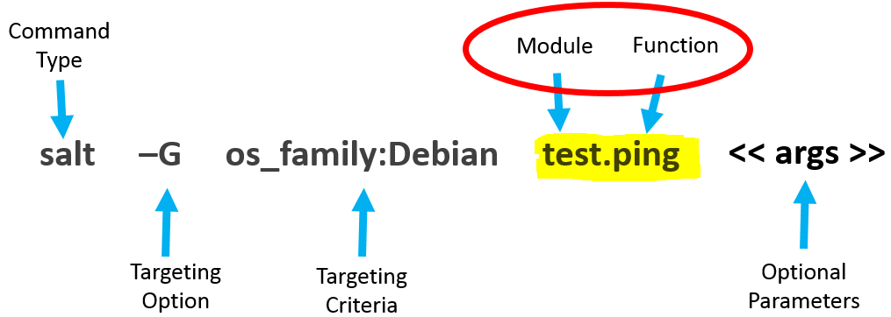
Execution Modules
Ad-hoc Commands
2 Parts:
(a) Module – e.g. test
(b) Function – e.g. ping
Test Mode (Test=True)
Example Modules:
pkg.install → salt ‘*’ pkg.install apache2
service.status → salt ‘*’ service.status apache2
sys.doc → salt ‘*’ sys.doc service.status
cmd.run → salt ‘*’ cmd.run ‘sudo mkdir /home/salt-folder’
http://salt-zh.readthedocs.io/en/latest/ref/modules/all/index.html#all-salt-modules

Slide 31
To The Terminal!
Install Apache (Execution Module)
1. Ubuntu

Slide 32
States - Intro
Files which describe the desired state of a minion << .SLS extension >>
Installing Packages…. Modifying Files…. Updating Permissions
Organizational Options (Monolith vs. Modular)
Monolith → Execute state files directly on minions
Modular → Execute a top.sls file (which will run multiple states correctly)
State Modules vs. Execution Modules
State Modules call Execution Modules
However, States allow for more options
1. Idempotency…. 2. Return Data
(SaLt State file)
https://docs.saltstack.com/en/2015.8/ref/states/all/index.html

Slide 33
States
1. File System Layout
/srv/salt/apache/init.sls
/srv/salt/apache/apache.conf
2. YAML
Human-Readable Format
For Configuration Files
3. Declarations
Steps within a State
4. Requisites
Enforce Orchestration (Require… Watch… Onchanges…..)

Slide 34
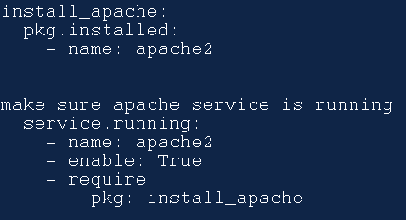
States
1. File System Layout
/srv/salt/apache/init.sls
/srv/salt/apache/apache.conf
1. /srv/salt/apache/init.sls

Slide 35
States
1. File System Layout
/srv/salt/apache/init.sls
/srv/salt/apache/apache.conf
2. YAML
Human-Readable Format
For Configuration Files
1. /srv/salt/apache/init.sls
2. YAML

Slide 36
States
1. File System Layout
/srv/salt/apache/init.sls
/srv/salt/apache/apache.conf
2. YAML
Human-Readable Format
For Configuration Files
3. Declarations
Steps within a State
1. /srv/salt/apache/init.sls
3. DECLARATION:
(a) ID
(b) Module.Function
(c) Argument(s)
2. YAML

Slide 37
States
Execution Module: salt ‘*’ pkg.install apache2
1. File System Layout
/srv/salt/apache/init.sls
/srv/salt/apache/apache.conf
2. YAML
Human-Readable Format
For Configuration Files
3. Declarations
Steps within a State
1. /srv/salt/apache/init.sls
3. DECLARATION:
(a) ID
(b) Module.Function
(c) Argument(s)
2. YAML

Slide 38
States
1. File System Layout
/srv/salt/apache/init.sls
/srv/salt/apache/apache.conf
2. YAML
Human-Readable Format
For Configuration Files
3. Declarations
Steps within a State
4. Requisites
Enforce Orchestration (Require.… Watch….)
1. /srv/salt/apache/init.sls
3. DECLARATION:
(a) ID
(b) Module.Function
(c) Argument(s)
2. YAML
4. REQUISITE:
(a) Require

Slide 39
States
1. File System Layout
/srv/salt/apache/init.sls
/srv/salt/apache/apache.conf
2. YAML
Human-Readable Format
For Configuration Files
3. Declarations
Steps within a State
4. Requisites
Enforce Orchestration (Require…. Watch….)
1. /srv/salt/apache/init.sls
3. DECLARATION:
(a) ID
(b) Module.Function
(c) Argument(s)
2. YAML
4. REQUISITE:
(a) Require
salt ‘*’ state.sls apache

Slide 40
To The Terminal!
Install Apache (State Module)
Ubuntu
CentOS …. Fail!

Slide 41



States – Apache Problems

Slide 42



States – Apache Problems

Slide 43
States – Apache Problems
Package Name: “apache2”

Slide 44


States – Apache Problems
Package Name: “apache2”

Slide 45
States – Apache Problems
Package Name: “apache2”
Package Name: “httpd”

Slide 46
States – Our Original .SLS File
1. /srv/salt/apache/init.sls
3. DECLARATION:
(a) ID
(b) Module.Function
(c) Argument(s)

Slide 47
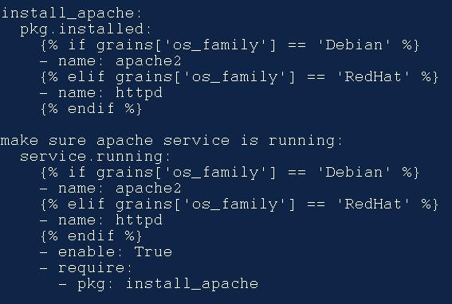
States – New .SLS File (w/ Jinja2)
Jinja2
Templating Language
Add Complex Logic
IF… WHILE, etc.
{% … %}

Slide 48
States – New .SLS File (w/ Jinja2)
ORIGINAL:
/srv/salt/apache/init.sls
with JINJA LOGIC:
/srv/salt/apache/init.sls

Slide 49
To The Terminal!
Install Apache (State Module)
Ubuntu
CentOS …. Success!

Slide 50


Salt Top.sls File (Master)
srv
salt
top.sls
nginx
.sls
nginx
.conf

Slide 51
Salt Top.sls File (Master)
srv
salt
top.sls
nginx
.sls
nginx
.conf

Slide 52
Salt File System (Master)
1
salt ‘*’ state.apply
srv
salt
top.sls
nginx
.sls
nginx
.conf

Slide 53
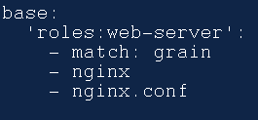
Salt File System (Master)
salt ‘*’ state.apply
srv
salt
2
/srv/salt/top.sls
top.sls
nginx
.sls
nginx
.conf

Slide 54
Salt File System (Master)
salt ‘*’ state.apply
srv
salt
3
/srv/salt/top.sls
top.sls
nginx
.sls
nginx
.conf

Slide 55
Salt File System (Master)
salt ‘*’ state.apply
srv
salt
4
/srv/salt/top.sls
top.sls
nginx
.sls
nginx
.conf

Slide 56



Next Steps…
Jinja2
Pillars
.SLS Files (aka. State Tree) Organization
Salt Best Practices
Salt and Friends!

Slide 57
Other Features
Beacons
Reactors
Runners
Returners
Database Connectivity
File System Connectivity
Salt-Cloud

Slide 58




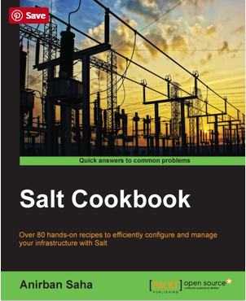
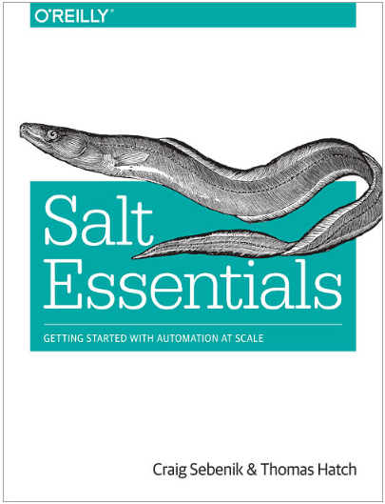

SaltStack Resources
https://app.pluralsight.com/library/courses/salt-getting-started/table-of-contents
https://app.pluralsight.com/library/courses/advanced-salt-master-tools/table-of-contents
https://www.packtpub.com/networking-and-servers/learning-salt
https://docs.saltstack.com/en/latest/

Slide 59

Thanks!

Slide 60
Salt File System (Master)
srv
srv
salt
salt
top.sls
nginx
.sls
nginx
.conf
top.sls
nginx
init.sls
nginx
.conf

Slide 61



Load Balancer App!
srv
salt
top.sls
hwaas-site
.sls
nodejs-package
.sls
load-balance
init.sls
nginx
.conf

Slide 62
Load Balancer App!
srv
salt
top.sls
hwaas-site
.sls
nodejs-package
.sls
load-balance
init.sls
nginx
.conf

Slide 63
Load Balancer App!
srv
salt
top.sls
hwaas-site
.sls
nodejs-package
.sls
load-balance
init.sls
nginx
.conf

Slide 64
Load Balancer App!
srv
salt
top.sls
hwaas-site
.sls
nodejs-package
.sls
load-balance
init.sls
nginx
.conf

Slide 65
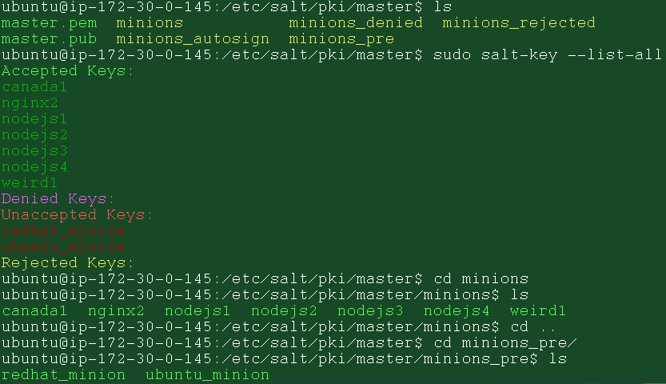
Installation and Authenication
1. Install salt-master:
Ad-hoc commands for Salt
2. Install salt-minion:
Static information about Minions
3. Store the master’s IP and Fingerprint:
Secured, user-defined data on the Master… and assigned to Minions
4. Accept each minion’s key:
salt-key command
Master must be on a Linux server!
Ports 4505 and 4506
Bi-Directional Communication
Encrypted AES Fingerprints

Slide 66
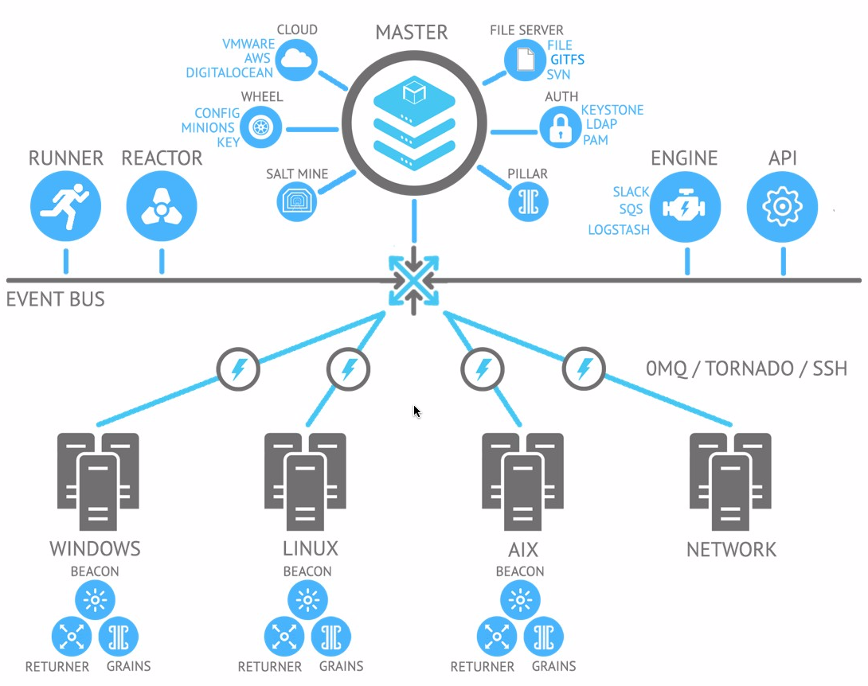
Architecture
1. Master-Minion(s)

Slide 67
Salt State System
xxxx
xxxx
xxxx
xxxx:
xxxx
xxxx
xxxx
xxxx
xxxx
xxxx

Slide 68
Key Terms
Master
Minion
Remote Execution (Pub/Sub)
Targeting
Globbing (vs. Regular Expressions)
Execution Modules
Functions
Grains
States
YAML
Jinja2
Configuration Management (Role Based)
Top .SLS File
Highstate
Pillars
Requisites (Watch | Require | ???)
Orchestration
Runners … Returners
Salt Event Bus
Beacons
Reactors
Salt-Cloud

Slide 69
salt master - sends cmds to minions
salt minions - receives cmds from master
execution modules - ad hoc cmds
formulas (states) - representation of a system configuration, a grouping of one or more state files with maybe pillar data and configuration files or anything else which define a neat package for a particular application.
grains - static information about minions
pillar - secure user-defined variables stored on master and assigned to minions (equivalent to data bags in Chef or Hiera in Puppet)
mine - area on the master where result from minion executed commands can be stored, like IP address of a backend webserver used then to configure a load balancer
top file - matches formulas and pillar data to minions
runners - modules executed on master
returners - inject minion data to another system on systems without minions
renderers - components that runs the template to produce valid state of configuration files, the default one use Jinja2 syntax and output YAML files.
reactor - trigger reaction on events
thorium - a new kind of reactor, still experimental.
beacons - little piece of code on the minion that are listening for thing, like server failure or file changes to inform the master. With reactor can be used to do self healing
proxy minions - translate Salt Language to device specific instruction to bring it to the desired state using its API or over SSH.
salt cloud - bootstrap cloud nodes
salt ssh - run cmds on systems without minions

Slide 70
Configuration
/etc/salt/master
Master’s Configuration File
/etc/salt/pki/master
Store public keys
etc/salt/minion.d
Minion Configuration File:
Specify the master’s address
#master: salt
Specify the minion’s ID
#id: ‘ ’
Authenticate the master
#master_finger: ‘ ’
Override values with .conf files

Slide 71
Salt File System (Master)
srv
salt
pillar
top.sls
nodejs
.sls
hwaas
.sls
load-balance
top.sls
mine.sls
init.sls
nginx
.conf

